Slide 1

EL123 Digital Logic Design
LECTURE 09
Functions of Combinational Logic
Engr.Hammad Munami

Slide 2
Introduction
Now we discuss some of the major functions of Combinational Logic including:
  Adders,
  Comparators,
  Decoders,
  Encoders,
  Code Converters,
  Multiplexers (data selectors),
  Demultiplexers, and
  Parity generators/checkers
Engr.Hammad Munami

Slide 3
Half and Full Adders
Adders are important in computers and also in other types of digital systems in which numerical data are processed.
An understanding of the basic adder operation is fundamental to the study of digital systems.
In this section, the half-adder and the full-adder are introduced.
Engr.Hammad Munami

Slide 4
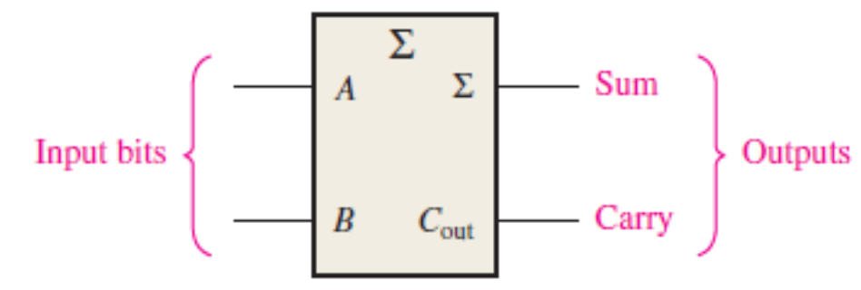
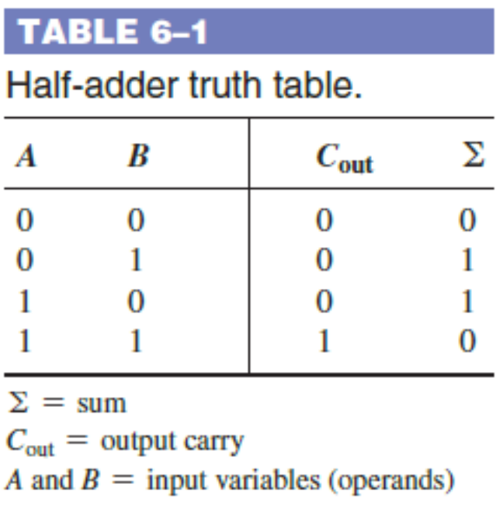
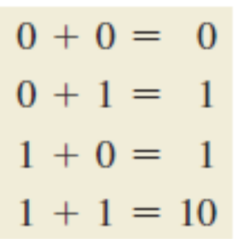
The Half-Adder
A half-adder adds two bits and produces a sum and an output carry.
Engr.Hammad Munami

Slide 5


The Half-Adder
From the operation of the half-adder as stated in Table 6–1, expressions can be derived for the sum and the output carry as functions of the inputs.
Notice that the output carry (C_{out}) is a 1 only when both A and B are 1s; therefore, C_{out} can be expressed as the AND of the input variables.
Now observe that the sum output is a 1 only if the input variables, A and B, are not equal.
The sum can therefore be expressed as the exclusive-OR of the input variables.
Engr.Hammad Munami

Slide 6
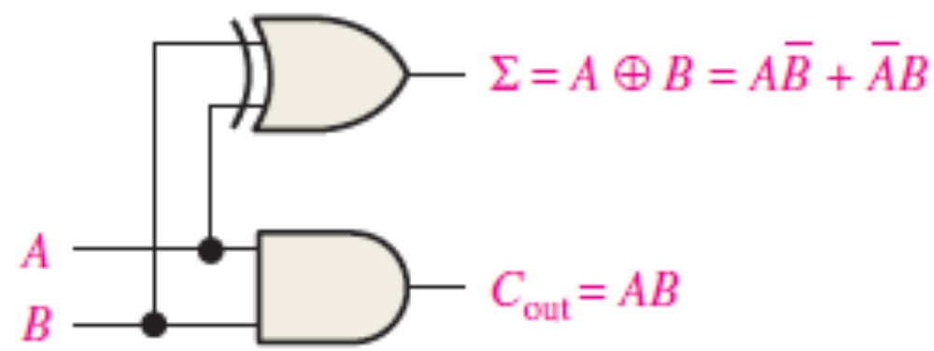
Half-Adder Logic Diagram
Engr.Hammad Munami

Slide 7
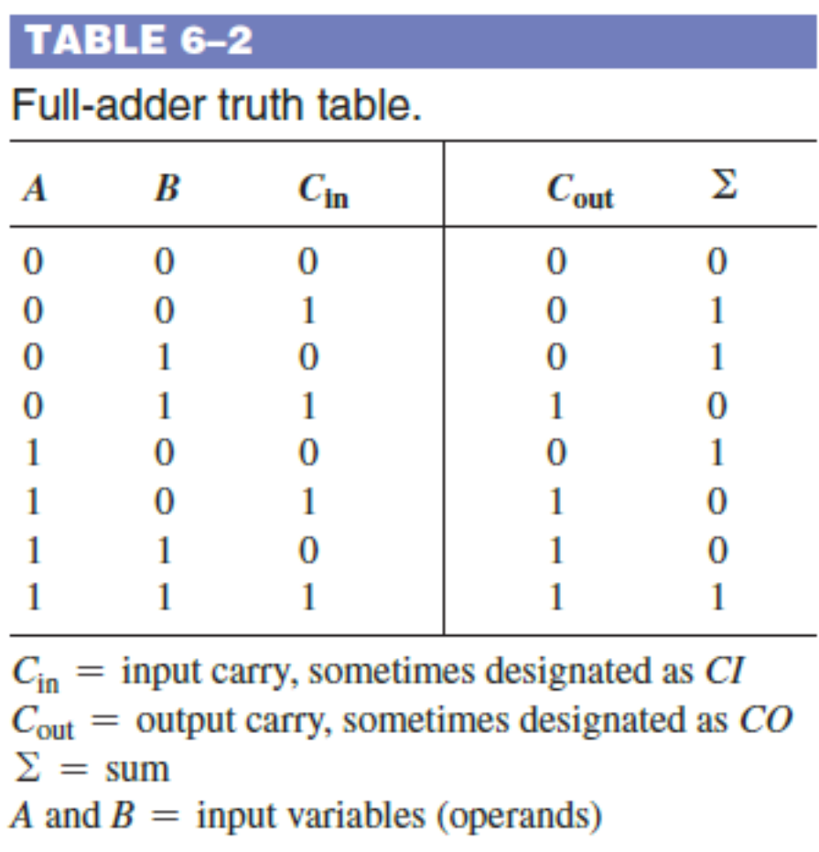
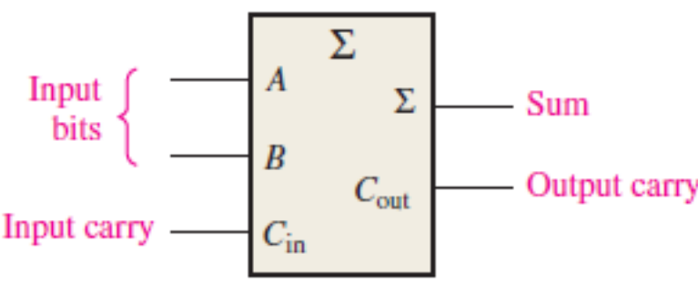


The Full-Adder
The second category of adder is the full-adder.
The full-adder accepts two input bits and an input carry and generates a sum output and an output carry.
Engr.Hammad Munami

Slide 8
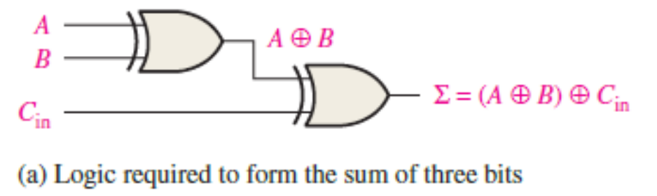
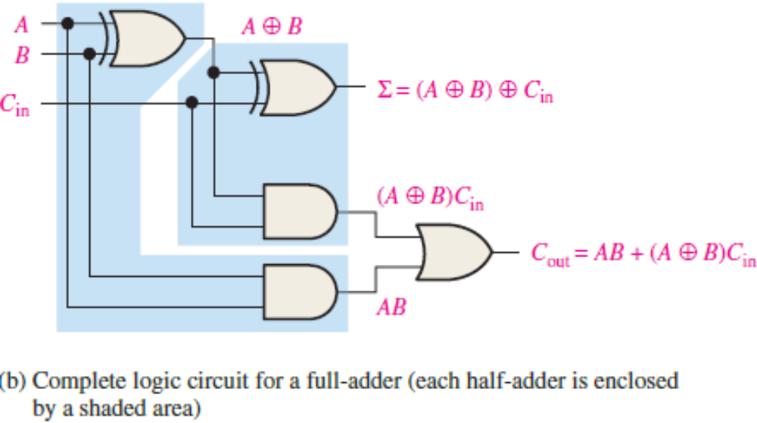
Full-Adder Logic Diagram
Engr.Hammad Munami

Slide 9
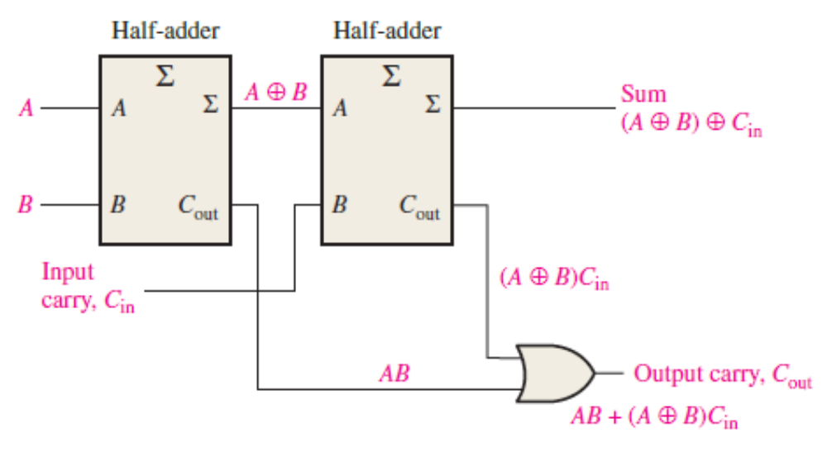
Arrangement of two half-adders to form a full-adder
Engr.Hammad Munami

Slide 10
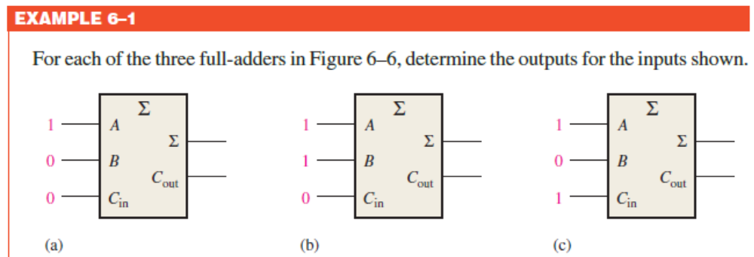
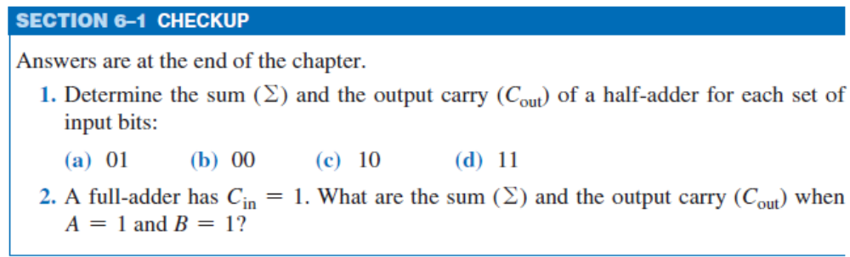
Engr.Hammad Munami

Slide 11

Parallel Binary Adders
A single full-adder is capable of adding two 1-bit numbers and an input carry.
To add binary numbers with more than one bit, you must use additional full-adders. When one binary number is added to another, each column generates a sum bit and a 1 or 0 carry bit to the next column to the left, as illustrated here with 2-bit numbers.
Engr.Hammad Munami

Slide 12
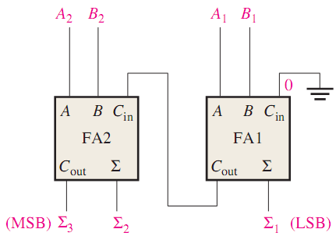
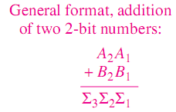
Parallel Binary Adders
To add two binary numbers, a full-adder (FA) is required for each bit in the numbers.
So for 2-bit numbers, two adders are needed; for 4-bit numbers, four adders are used; and so on.
The carry output of each adder is connected to the carry input of the next higher-order adder
Engr.Hammad Munami

Slide 13
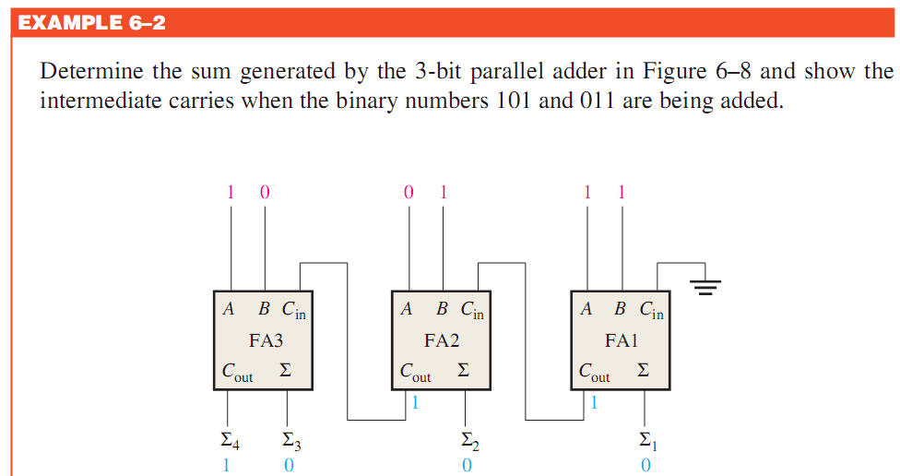
Parallel Binary Adders
Engr.Hammad Munami

Slide 14
Four-Bit Parallel Adders
A group of four bits is called a Nibble.
A basic 4-bit parallel adder is implemented with four full-adder stages as shown in Figure,
Again, the LSBs (A1 and B1) in each number being added go into the right-most full-adder; the higher-order bits are applied as shown to the successively higher-order adders, with the MSBs (A4 and B4) in each number being applied to the left-most full-adder.
The carry output of each adder is connected to the carry input of the next higher-order adder as indicated.
These are called internal carries.
Engr.Hammad Munami

Slide 15
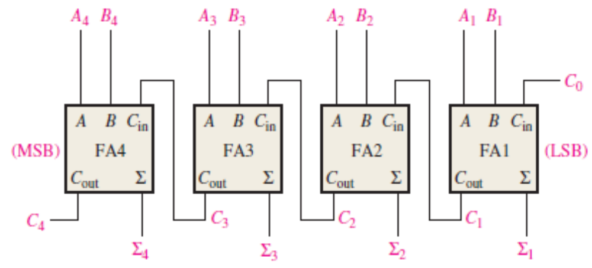
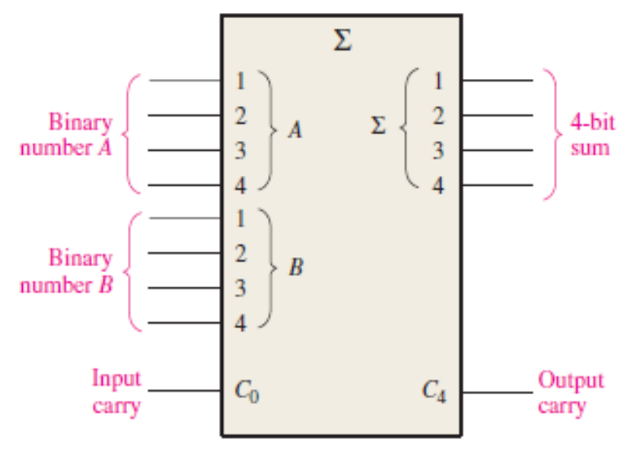
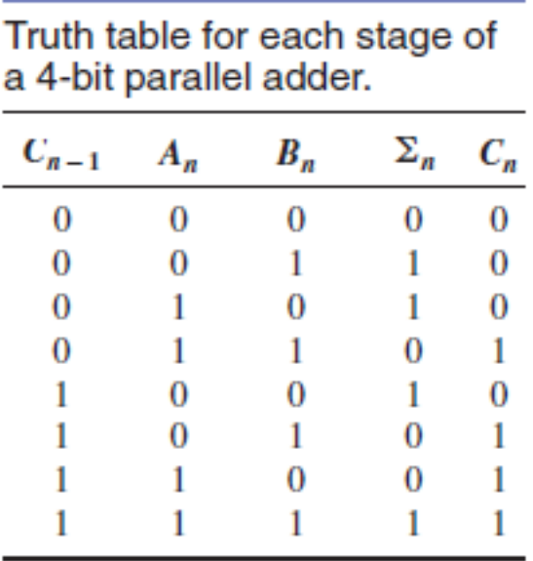
Engr.Hammad Munami

Slide 16
Use the 4-bit parallel adder to find the sum and output carry for the addition of the following two 4-bit numbers if the input carry is 0:
A4A3A2A1 = 1100 and B4B3B2B1 = 1100
Engr.Hammad Munami

Slide 17
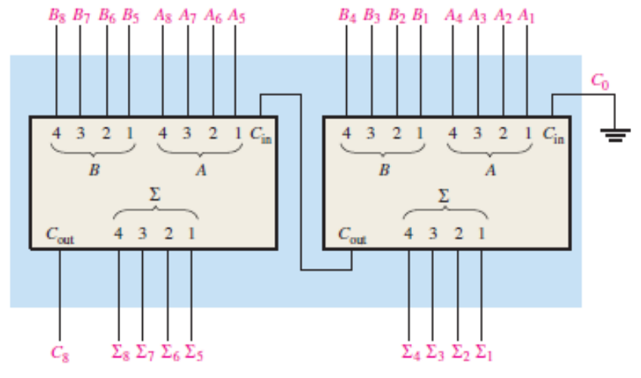
Adder Expansion
The 4-bit parallel adder can be expanded to handle the addition of two 8-bit numbers by using two 4-bit adders.
The carry input of the low-order adder (C₀) is connected to ground because there is no carry into the least significant bit position, and the carry output of the low-order adder is connected to the carry input of the high-order adder, as shown in Figure:
Engr.Hammad Munami

Slide 18
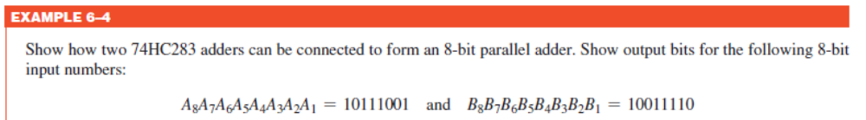
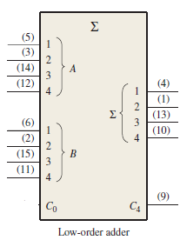
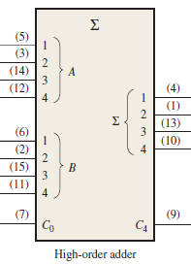



Engr.Hammad Munami

Slide 19
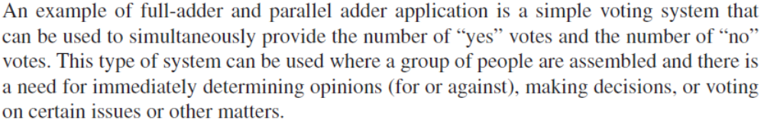
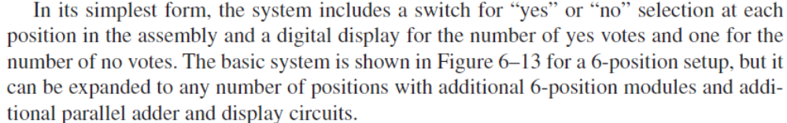
Application
Engr.Hammad Munami

Slide 20
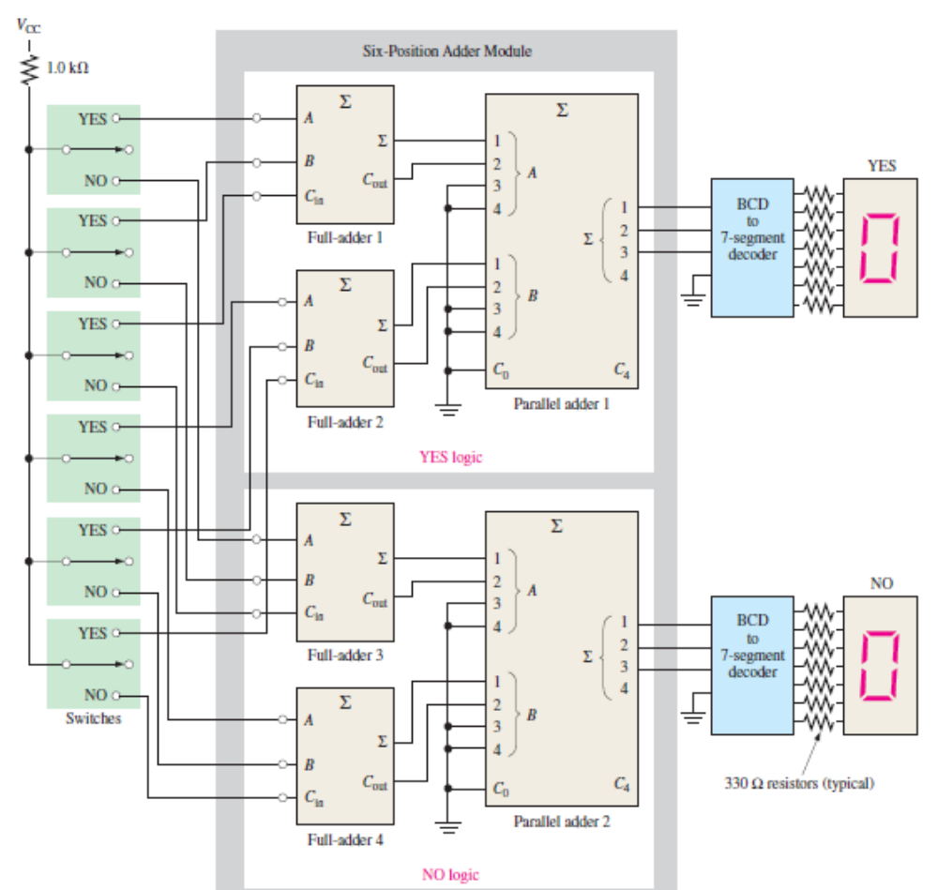
Engr.Hammad Munami

